Slide 1

University of Tabriz
EMBEDDED SYSTEMS COURSE PROJECT
IoT-ML Weather & Air Quality Monitoring System
STM32-Based Environmental Monitoring with Machine Learning Prediction
Team Members: [Behnam Gholam Zadeh(team leader)], [Sama Nouri], [Yashar Salmani], [Ali Aliloo], [Ali Arshia Maleki], [Helia Salmasi]
Course: Embedded Systems Engineering
Department of Electrical & Computer Engineering
July 2026

Slide 2
Contents
TABLE OF CONTENTS
01
Project Overview
Motivation, Objectives & System Features
02
System Architecture
Software Design, Modules & Scheduler
03
Machine Learning
Pipeline, Model Training & Performance
04
Results & Deployment
Embedded ML, System Output & Future Work
05
Conclusion
Summary & Key Takeaways
2

Slide 3
Project Overview: IoT-ML Environmental Monitoring
01 Project Overview
MOTIVATION
OBJECTIVES
Why This Project?
Project Goals
Air pollution is a major health concern. Real-time PM2.5 monitoring enables early warnings and data-driven decisions.
This project demonstrates a low-cost embedded solution with IoT sensing and ML prediction.
• Build a modular embedded system on STM32 platform
• Acquire and filter environmental sensor data
• Calculate Air Quality Index (AQI) in real-time
• Predict future PM2.5 using ML on the edge
• Report all data through UART interface
FEATURES
PLATFORM
Key Capabilities
Target Hardware
• Multi-sensor data acquisition
• Digital PM2.5 filtering
• Real-time AQI calculation
• Lightweight ML prediction
• Hazardous air quality alarm
• UART data logging
• MCU: STM32F03C8T6 ARM Cortex-M3
• Library: STM32 HAL
• IDE: Keil MDK (uVision 5) + STM32CubeMX
• Language: C (Embedded Firmware), Python (Machine Learning)
• ML: Scikit-learn + Jupyter Notebook
• Interface: UART
3

Slide 4
Overall Software Architecture
02 System Architecture
Modular pipeline design — all modules communicate through a shared system data structure
Shared Data Structure
Mock Sensor
Design Principles
SystemData_t:
temperature (float)
humidity
pressure (float)
pm25_raw (int)
pm25_filtered (int)
aqi (int)
aqi_category (enum)
prediction (float)
alarm_status (bool)
CO2
…
All modules read/write this shared structure for inter-module communication
Modularity
Each module has a single, well-defined responsibility with clean interfaces
Testability
Independent modules can be unit tested in isolation before integration
Scalability
New modules (Wi-Fi, LCD, SD Card) can be added without modifying existing code
Determinism
Cooperative scheduling ensures predictable execution order and timing
Filter — Moving Average
AQI Calculator — Index Computation
Predictor (ML) — Linear Regression
Alarm Manager — Hazard Detection
UART Logger — Data Reporting
4

Slide 5
Software Modules
02 System Architecture
Table 1. Software module responsibilities and descriptions
Module | Responsibility | Description
Scheduler | Manages execution timing and module sequencing | Uses HAL_GetTick() to call each module's Update() function in a deterministic order
Mock Sensor | Simulates environmental sensor readings | Generates synthetic data for temperature, pressure, and PM2.5 for system testing
Filter | Smooths noisy PM2.5 measurements | Applies a moving average filter to reduce sensor noise and improve signal quality
AQI | Calculates Air Quality Index | Converts filtered PM2.5 values to AQI using EPA standard breakpoint tables
Predictor | ML-based PM2.5 prediction | Performs lightweight linear regression inference to predict future PM2.5 concentration
Alarm | Detects hazardous conditions | Monitors AQI and predicted values; triggers alarm when thresholds are exceeded
Logger | System data reporting | Formats and outputs all system data through UART for monitoring and debugging
Key Insight: Each module follows the same interface pattern — an Init() function and an Update() function — enabling easy testing, replacement, and extension of individual components.
5

Slide 6
Scheduler Flow
02 System Architecture
Scheduler Characteristics
while(1) { ... }
Pseudocode
Cooperative Design
Modules yield control; no preemption
HAL_GetTick()
System tick for deterministic timing
No RTOS Required
Eliminates RTOS overhead
Deterministic Order
Predictable execution sequence
Scheduler_Run()
void main(void) {
System_Init();
while (1) {
Scheduler_Run();
}
}
void Scheduler_Run(void)
{
MockSensor_Update();
Filter_Update();
AQI_Update();
Predictor_Update();
Alarm_Update();
}
MockSensor_Update()
Filter_Update()
AQI_Update()
Predictor_Update()
Alarm_Update()
Logger_Report()
6

Slide 7
Machine Learning Pipeline
03 Machine Learning
Offline model development in Python → Embedded deployment on STM32
Dataset
Preprocessing
Features
Train/Test Split
Lin. Regression
Evaluate
Historical PM2.5, temperature, and pressure sensor records
Data cleaning, missing value handling, outlier removal
Create lag features: PM25_prev1, prev2, prev3
80% training, 20% testing with random shuffle
Scikit-learn LinearRegression model training
MAE, RMSE, R2 metrics on test set
Input Features (6)
Output (1)
• PM2.5 — Current concentration
• PM25_prev1 — Previous (t-1)
• PM25_prev2 — Two steps back (t-2)
• PM25_prev3 — Three steps back (t-3)
• Temperature — Ambient temp
• Pressure — Atmospheric
Future PM2.5 Prediction
Predicts the PM2.5 concentration one time step ahead using linear regression on the 6 input features.
Model: y = w1*x1 + w2*x2 + ... + w6*x6 + b
Deployment: After training, model weights and bias are extracted and manually transferred into the STM32 firmware as C array constants — no ML framework required on the embedded device.
7

Slide 8
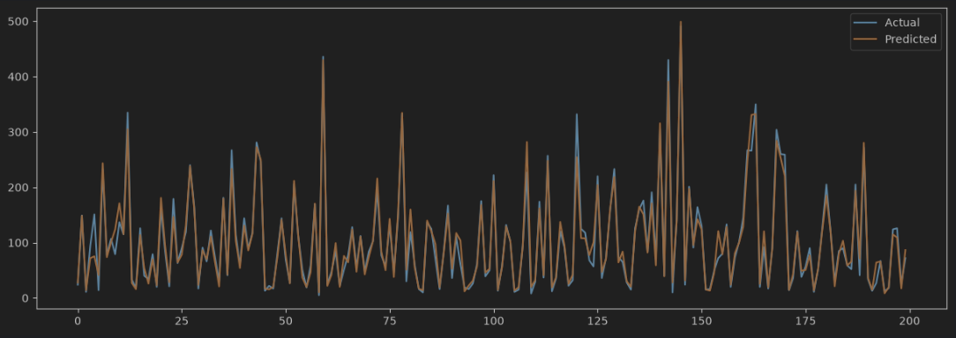
Model Performance
03 Machine Learning
Table 2. Linear Regression Model Evaluation Metrics
Figure 1. Real vs Predicted PM2.5 Values
Metric | Value | Assessment
MAE | 12.98 | Good
RMSE | 25.36 | Acceptable
R² Score | 0.93 | Excellent
Analysis
R2 = 0.92 explains 92% of variance. Linear Regression is ideal for embedded deployment.
Key Advantage: Linear Regression achieves high accuracy (R2 = 0.93) while remaining computationally lightweight — requiring only multiply-accumulate operations, ideal for resource-constrained STM32 microcontrollers.
8

Slide 9
Embedded ML Deployment
04 Results & Deployment
Python
Scikit-learn
Training
Linear Regression
Weights & Bias
6 weights + 1 bias
predictor.c
C Implementation
Prediction Equation
$$\overset{^}{y}=∑_{i=1}^{6}(w_{i}⋅x_{i})+b$$
Offline Training
Embedded Inference
No ML Framework
Lightweight Edge AI
Python with Scikit-learn for model development
Pure C implementation on STM32 ARM Cortex-M4 with deterministic execution
Only basic arithmetic operations needed — no TensorFlow, no libraries, minimal memory footprint
28 bytes of RAM for weights, sub-millisecond inference — ideal for battery-powered IoT devices
Workflow: Train in Python → Extract coefficients → Hard-code in C → Compile and flash to STM32 → Run inference at the edge without any external dependencies.
9

Slide 10
Final System Output
04 Results & Deployment
Complete Data Processing Pipeline
Sensors
Filter
AQI
ML Predict
Alarm
UART
Sample UART Output
UART Terminal — COM3 (115200 baud)
System Summary
[10:00:01] System initialized
[10:00:02] Scheduler started
[10:00:05] ==================
[10:00:05] Temperature: 28 C
[10:00:05] Pressure : 1013 hPa
[10:00:05] PM2.5 : 63 ug/m3
[10:00:05] AQI : 87 (Moderate)
[10:00:05] Prediction : 69 ug/m3
[10:00:05] Alarm : OFF
[10:00:05] ==================
Real-Time Processing
Data processed in milliseconds on STM32
Multi-Stage Pipeline
Filter → AQI → ML → Alarm → UART
UART Reporting
Full system state every cycle
Actionable Insights
AQI and alarm for awareness
10

Slide 11
Future Improvements
04 Results & Deployment
Real Sensors
LCD Display
SD Card Logging
Wi-Fi Module
Replace mock data with BME280 and PMS5003 physical sensors for real-world deployment
Add a 16x2 character or TFT LCD for local real-time data visualization without a PC
Store historical data locally for long-term trend analysis and offline review
Integrate ESP8266 or ESP32 for wireless connectivity and remote data access
MQTT Protocol
Cloud Dashboard
TinyML / TFLite
Low Power Mode
Publish sensor data to an MQTT broker for IoT integration and messaging
Web-based visualization with real-time charts, historical trends, and alerts
TensorFlow Lite for Microcontrollers for more complex on-device ML models
Implement sleep/wake cycles for battery-operated outdoor deployment
Development Roadmap
Phase 1: Mock sensors + Modular software architecture + Corporative Scheduler + AQI Calculation + PM2.5 filtering + UART — Complete
Phase 2: Real sensors + Machine Learning prediction + Embedded ML deployment + Advanced alarm & hysteresis + Improved system reporting — Complete
Phase 3: Wi-Fi + MQTT + Cloud + TinyML — Planned
11

Slide 12
Thank You
THANK YOU FOR YOUR ATTENTION
Modular Embedded Architecture
Real-Time Environmental Monitoring
AQI Analysis & Alarm System
Machine Learning Prediction
Lightweight Embedded AI
Scalable IoT Platform
IoT-ML Weather & Air Quality Monitoring System
Embedded Systems Course Project
Q & A
Questions and Discussion
12

